Slide 1

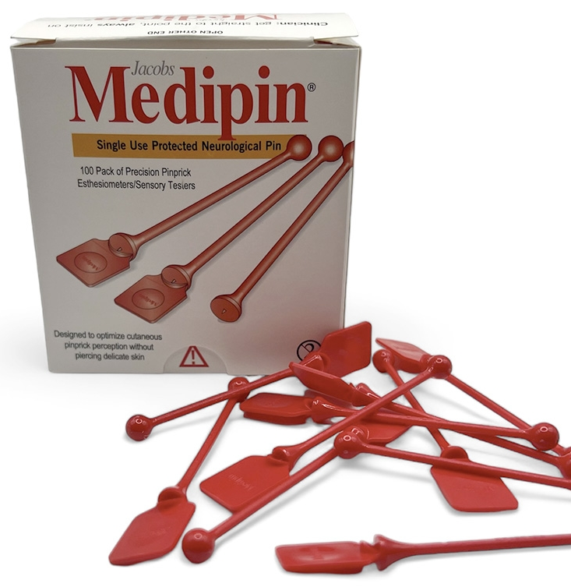
For earlier diagnosis of
diabetic neuropathy
Medipin Limited
www.medipin.net
sales@medipin.net +44 (0)780 1986 515

Slide 2
Why Medipin is needed
50%+ of diabetic patients develop peripheral neuropathy.
Current tools (10g monofilament, finger touch and tuning fork) often miss early 'small-fibre' nerve loss in diabetes.
Delayed diagnosis increases risk of ulceration, amputation, and mortality
1. Armstrong DG, et al. Guest Editorial: are diabetes-related wounds and amputations worse than cancer? Int Wound J
2007;4(4):286–7.
2. Rice et al 2014; Burden of Diabetic Foot Ulcers for Medicare and Private Insurers Diabetes Care;37:651–658 DOI:10.2337/dc13-2176

Slide 3
Medipin: The Purpose-Built Solution
Medipin is a novel, inexpensive and highly sensitive, single-use instrument for detecting early signs of small fibre nerve damage by safely and rapidly testing pinprick sensation

Slide 4
Clinically Validated in Primary Care
In 2024 NHS NIHR/MRC study detected signs of neuropathy in more patients than monofilament.
Captures small-fibre deficits — earlier than standard tools.
Results published in Primary Care Diabetes journal, Oct 2024.
https://doi.org/10.1016/j.pcd.2024.10.003

Slide 5
Clinically Validated in Primary Care
Validated in structured, nurse-led care pathways
Aligns with US ADA and CMS quality measures (MIPS 126, 127, eMeasure 123)
Strong use case for primary care, diabetic clinics, and RN-driven toolkits
https://doi.org/10.2337/cd23-0103

Slide 6
Safe, Precise, and Cost Efficient
Designed to enhance diagnostic accuracy in the testing of pinprick sensation without breaking delicate skin and its’ medical applications are widespread including..

Slide 7
Applications & Large Market
Diabetic foot clinics and primary care practices.
Neurology, ER, orthopaedics, spinal units.
Suitable for hospital and home-health use.
Market driven by rising diabetes rates and need for early detection.

Slide 8
Financial Impact Potential
25 million insured individuals in modeled population
2.5 million (10%) estimated with diabetic symptoms
75,000 patients per year undergo critical diabetic treatment
Average treatment cost: $11,500
Total annual spend: $862.5 million

Slide 9
Financial Impact Potential
Early detection with Medipin could prevent 10–15% of these cases
Potential savings: $86–129 million per year
Five-year impact: Up to $645 million in cumulative savings

Slide 10
Distribution Opportunity
U.S. FDA registration #9068825 – Class I exempt.
ISO 14971 and voluntarily 13485 - compliant manufacturing and documentation ready.
Currently onboarding with NHS Supply Chain.
Seeking distributors and purchasing networks in the U.S.

Slide 11
Get in Touch
Medipin Limited
24 Chiltern Avenue, Bushey, Hertfordshire,
WD23 4QB, UK
Website: www.medipin.net
Email: sales@medipin.net
Phone: +44 (0)780 1986 515

