Slide 1

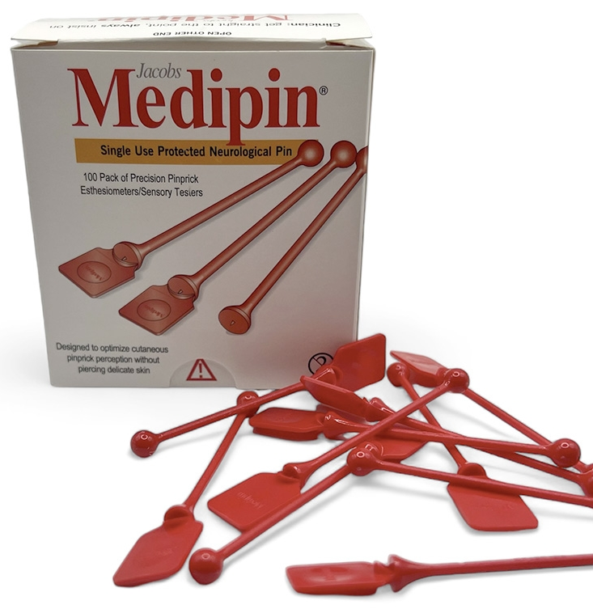
For earlier diagnosis of
diabetic neuropathy
Medipin Limited
www.medipin.net
sales@medipin.net +44 (0)780 1986 515

Slide 2
Why Medipin is needed
50%+ of diabetic patients develop peripheral neuropathy.
Current tools (10g monofilament, finger touch and tuning fork) often miss early 'small-fibre' nerve loss in diabetes.
Delayed diagnosis increases risk of ulceration, amputation, and mortality
1. Armstrong DG, et al. Guest Editorial: are diabetes-related wounds and amputations worse than cancer? Int Wound J 2007;4(4):286–7.
2. Rice et al 2014; Burden of Diabetic Foot Ulcers for Medicare and Private Insurers Diabetes Care;37:651–658 DOI:10.2337/dc13-2176
3. Burgess, J, et al. Early Detection of Diabetic Peripheral Neuropathy: A Focus on Small Nerve Fibres. Diagnostics 2021, 11, 165. https://doi.org/10.3390/diagnostics11020165

Slide 3
Financial Impact
The total annual cost of managing diabetic peripheral neuropathy (DPN) and its complications in the USA is estimated to be between $4.6 billion and $13.7 billion
Earlier diagnosis allows earlier intervention

Slide 4
Medipin: The Purpose-Built Solution
Medipin is a novel, inexpensive and highly sensitive, single-use instrument for detecting early signs of small fibre nerve damage by safely and rapidly testing pinprick sensation

Slide 5
Clinically Validated in Primary Care
14 month NHS NIHR/MRC study June 2023 – August 2024
11 GP practices in England
389 adults with Type 2 Diabetes
Mean age 67 years (63% male, 37% female)

Slide 6
Clinically Validated in Primary Care
Medipin identified elevated risk in 38% patients versus 14% using monofilament.
Captures small-fibre deficits — earlier than standard tools.
Results published in Primary Care Diabetes journal, Oct 2024.
Stacey Fisher et al., Primary Care Diabetes, https://doi.org/10.1016/j.pcd.2024.10.003

Slide 7
Clinically Validated in Primary Care
Validated in structured, nurse-led care pathways
Aligns with US ADA and CMS quality measures (MIPS 126, 127, eMeasure 123)
Strong use case for primary care, diabetic clinics, and RN-driven toolkits
Increasing Diabetic Foot Exam Rates in Primary Care Via a Toolkit for Registered Nurses
https://doi.org/10.2337/cd23-0103

Slide 8
Safe, Precise, and Cost Efficient
Designed to enhance diagnostic accuracy in the testing of pinprick sensation without breaking delicate skin and its’ medical applications are widespread including..

Slide 9
Applications & Large Market
Diabetic foot clinics and primary care practices.
Neurology, ER, orthopaedics, spinal units.
Suitable for hospital and home-health use.
Market driven by rising diabetes rates and need for early detection.

Slide 10
Financial Impact Potential
25 million insured individuals in modelled population
2.5 million (10%) estimated with diabetic symptoms
75,000 patients per year undergo critical diabetic treatment
Average treatment cost: $11,500
Total annual spend: $862.5 million

Slide 11
Financial Impact Potential
Early detection with Medipin could prevent 10–15% of these cases
Potential savings: $86–129 million per year
Five-year impact: Up to $645 million in cumulative savings

Slide 12
Distribution Opportunity
U.S. FDA registration #9068825 – Class I exempt.
ISO 14971 and voluntarily 13485 - compliant manufacturing and documentation ready.
Currently onboarding with NHS Supply Chain.
Seeking distributors and purchasing networks in the U.S.

Slide 13
Get in Touch
Medipin Limited
24 Chiltern Avenue, Bushey, Hertfordshire,
WD23 4QB, UK
Website: www.medipin.net
Email: sales@medipin.net
Phone: +44 (0)780 1986 515

